Slide 1


Slide 2
HSI Campaign
Strengthening the HSI Culture
Competitive Preference Priority 1:
Meeting Student Social, Emotional, and Academic Needs
Projects that are designed to improve students' social, emotional, academic, and career development, with a focus on underserved students by creating a positive, inclusive, and identity-safe climate at institutions of higher education through one or more of the following activities:
(a) Fostering a sense of belonging and inclusion for underserved students.
(b) Implementing evidence-based practices for advancing student success for underserved students.
(c) Providing evidence-based professional development opportunities designed to build asset-based mindsets for faculty and staff on campus and that are inclusive with regard to race, ethnicity, culture, language, and disability status.

Slide 3
HSI Campaign
Strengthening the HSI Culture
Practice
Awareness
Professional Development
Arts, Student Life, Community

Slide 4
HSI Campaign
Strengthening the HSI Culture
HSI campaign
  Keynote speaker Dr. Gina Garcia
  Utilization of Hispanic Serving Institution language through marketing, communications, social media, and human resources efforts.
  Swag items

Slide 5
HSI Campaign
Strengthening the HSI Culture
HSI internal marketing
  Simon Silva (https://www.simonsilva.com/)
  Wall coverings
  Canvas prints
  Window clings
  Posters
  Fall Return Rally t-shirts for all faculty and staff
  Panther Connect t-shirts for students

Slide 6

HSI Campaign

Slide 7

HSI Campaign

Slide 8
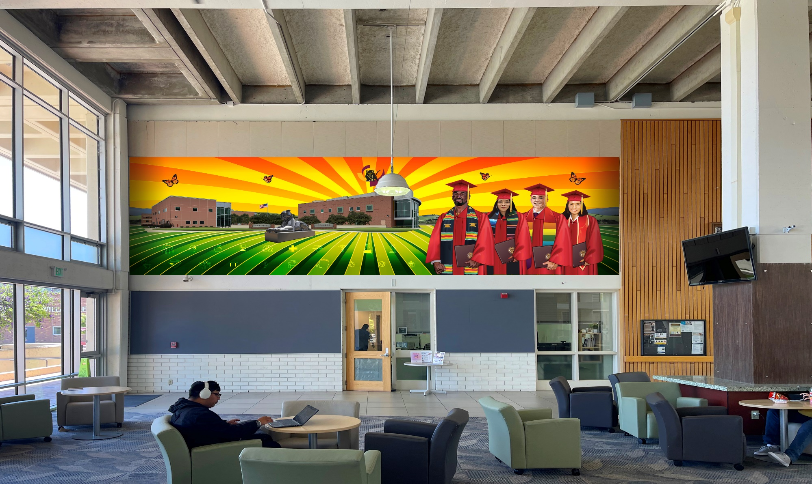
HSI Campaign

Slide 9
Hispanic Serving Institution
Q&A

